Slide 1
Perceptive Reach / IRDS
User Manual

Slide 2
Home
Selecting a button below will immediately direct you to that information in this user manual.
User Registration Instructions
VLER Direct Registration Instructions
Login/Logout Instructions
Access VLER Direct
Individual View
Application User Roles
REACH-VET Program Guidance
Locating Patient Information
Find Recommended Treatments
Facility View
Surveillance View
Update Outreach Status Checklist
Saving Notes in the Dashboard
Export information from the Dashboard
Customize the Dashboard

Slide 3
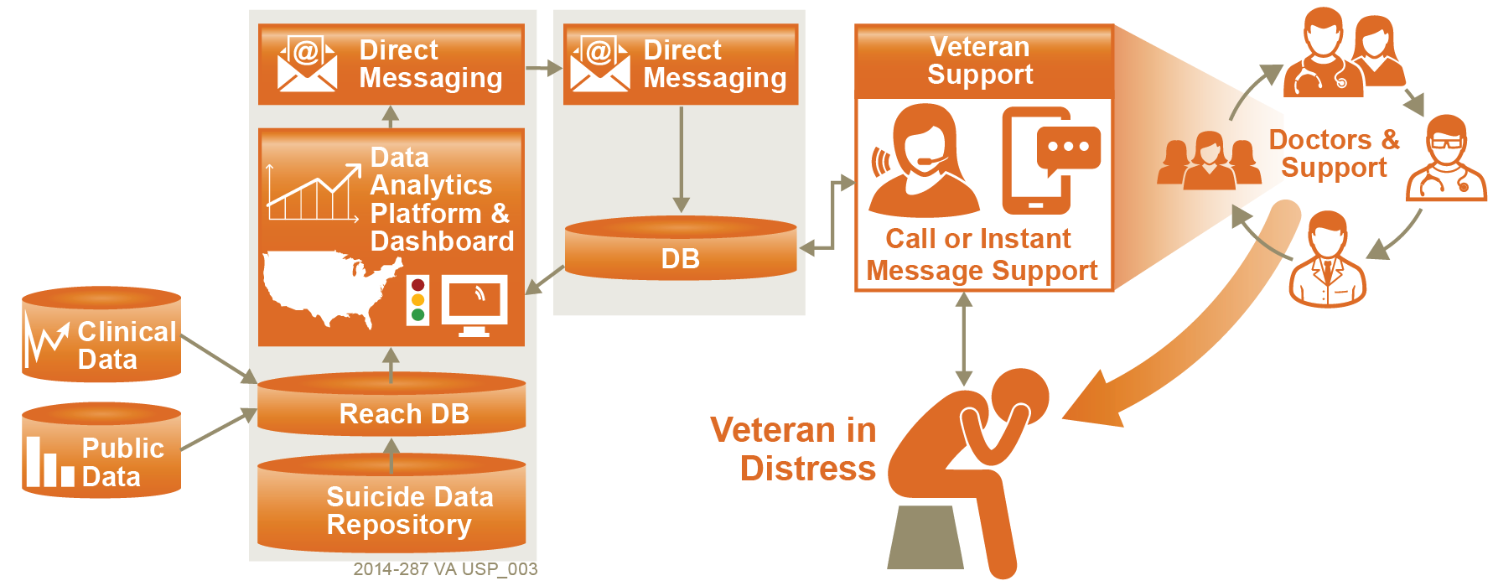
Perceptive Reach Application Overview
Upstream Suicide Prevention for Veterans – The REACH VET effort is supported by an IT program called Perceptive Reach. The Perceptive Reach innovation combines technology, outreach, and clinical support to deliver a clinically based data-driven early intervention and treatment solution aimed at suicide prevention.
Return Home

Slide 4
User Roles Overview
User Roles – Slide 1/2
Clinical Care Team Member – Has the ability to see Direct Messages and views in the Perceptive Reach Dashboard related to a specific VA facility service area and care of individual Veterans. Users include Suicide Prevention Coordinators and clinical care providers. The majority of users will be Clinical Care Team Members.
Clinical Care Supervisor – Has the same abilities as the Clinical Care Team Member but can be assigned to multiple facilities. This role is appropriate for VISN or other level users that may want to see data from multiple facilities, but not all facilities nationally.
National Supervisor – Has the ability to see Dashboard views with summaries of data at the state, VISN, or national level. Also has the ability to see lower level views in the Perceptive Reach Dashboard related to a specific VA facility service area and care of individual Veterans. To be approved for this level of access, the individual must have prior approved national level access to other VHA systems such as CPRS, VistA, CAPRI, etc.
Researcher – Has the ability to view data in the underlying IRDS database using tools such as BIRT, R, SQL, etc.
Reporter – Has the ability to view data in the underlying IRDS database using tools such as BIRT, R, SQL, etc. in addition to all levels of Dashboard views for reporting purposes.
System Administrator – Has all allowable Windows and SQL rights on server and access to all system components necessary for system administration activities including operations, maintenance, etc.
Return Home

Slide 5
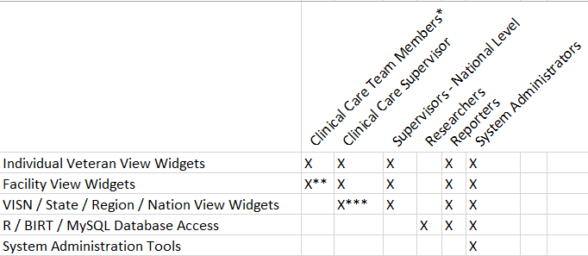
User Roles Overview
User Roles – Slide 2/2
User Role Matrix
*Clinical Care Team Member is a catchall term for a staff member who provides outreach and intervention services. (e.g. SPC, Social workers, care managers, physicians, psychologists, nurses, etc.)
**Clinical Care Team Members will have access to the Facility View for their home Facility only by default
***Clinical Care Supervisors (CCS) can be assigned which specific facilities they can see in their facility-level view. This allows VISN level users, for example, the ability to see the sites in their VISN (or a handful of sites), but not see all sites nationally.
Return Home

Slide 6
Perceptive Reach User Registration Instructions
To gain access to the Perceptive Reach IRDS Dashboard, download the form below.
In the form:
Please determine your role using the definitions on Slide 4.
New users must provide dates for VA Privacy and Information Security Awareness Training, VA Privacy Training, and Date of VA Background Investigation. If you do not have a specific date for the background investigation, please indicate the month and year.
After completing the form, please send it via email to the Perceptive Reach help desk (VAPerceptiveReachSupport@va.gov)
Return Home

Slide 7
VLER Direct Registration Instructions
Please follow instructions below to register for a VLER Direct account. After successfully creating an account, please send your VLER Direct address (…@direct.va.gov) to the Perceptive Reach help desk (VAPerceptiveReachSupport@va.gov). If you have any questions about setting up a VLER Direct account, please contact the VLER Direct team (VADirectRegistration@va.gov).
*Note – A PIV card must be used to register for VA Direct Messaging.
Steps:
1.) Follow the step-by-step instructions in the PDF attached below to create a VLER Direct account.
2.) After registering for VA Direct Messaging, send an email to VADirectRegistration@va.gov.
a. In response, you will receive an email with your VA Direct email address.
3.) When you receive this email, please login to VA Direct Messaging and follow the steps to set up Direct Messaging as described in the next video, “How to Set Up VA Direct,” that is also available here.
*Note – The links above must be accessed behind the VA Firewall.
Return Home

Slide 8
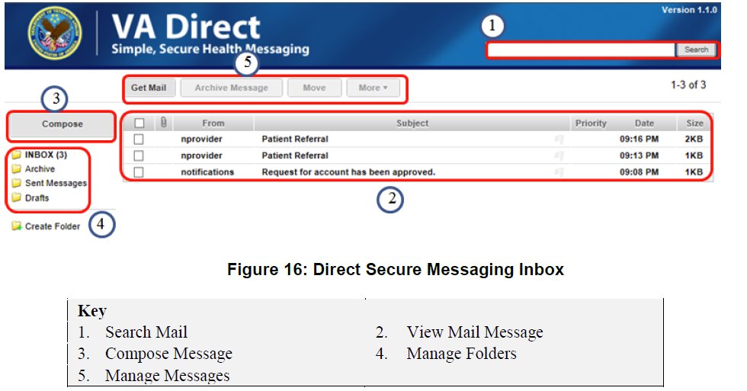
VLER Direct Access Instructions
VLER Direct – Slide 1/2
The Virtual Lifetime Electronic Record (VLER) email application is used to send Direct Messages to IRDS users about Veterans recently identified in the Dashboard. The VLER application is a VA-developed solution that allows messages to be sent securely to internal VA users, and possibly in the future, to non-VA care providers. The use of non-VA care providers is not planned for this phase of the project.
To access VLER Direct, select the following link – [Insert VLER Direct link]
Return Home

Slide 9
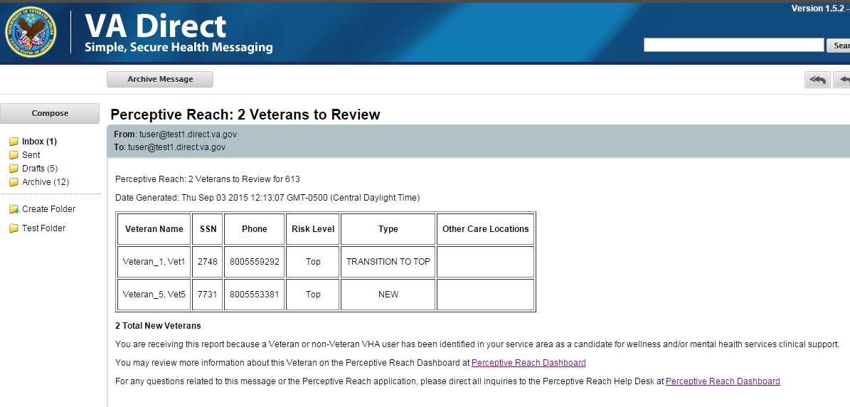
VLER Direct Message content
VLER Direct – Slide 2/2
VLER Direct Messages are sent to notify Perceptive Reach users of the Veterans identified in the Dashboard. Following a new risk score run, users should expect to receive one Direct Message for each of their assigned facilities. Each message includes information for all Veterans recently identified as high risk at a specific facility. The Direct Message will notify the user how many Veterans need to be reviewed along with additional information about each Veteran.
VLER Direct Messages also include a link to the IRDS Dashboard allowing the user quick access to the Veteran’s information.
Return Home

Slide 10
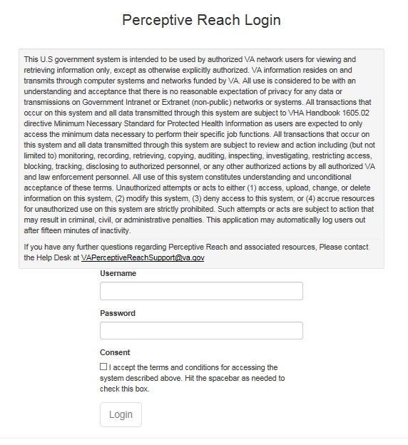
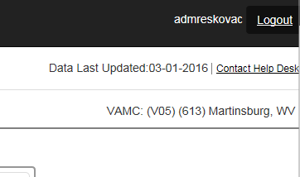
Login / Logout Instructions
To logout of the Dashboard, select the ‘Logout’ button in the top right corner of the Dashboard.
To login to the IRDS Dashboard, enter the following information on the login page:
VA Username
VA Password
Check the box to accept the Terms & Conditions
After entering in this information, select the ‘Login’ button.
Return Home

Slide 11
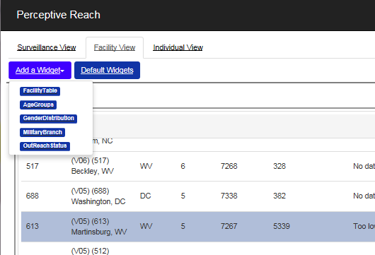
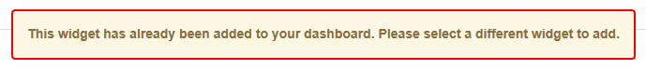
Customizing the Dashboard Adding a Widget
Customize the Dashboard– Slide 1/5
Users have the option to add and remove widgets from the Dashboard. To add a widget back to the Dashboard, select the ‘Add a Widget’ button. Upon selecting this button, a drop-down menu will appear. In this drop-down menu, select the widget you would like to add.
It is important to note that widgets cannot be added to the Dashboard multiple times. If a user tries to add multiple instances of the same widget to the Dashboard, they will receive an error message (see below).
Return Home

Slide 12
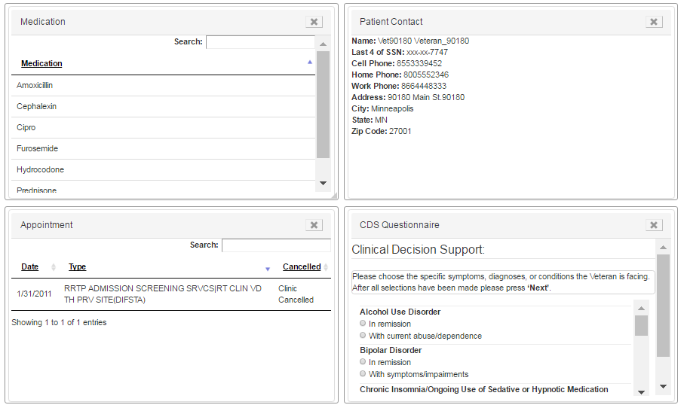
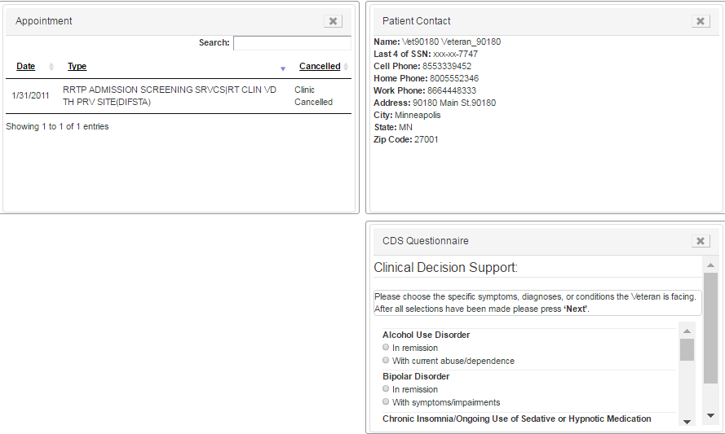
Customizing the Dashboard Removing a Widget
Customize the Dashboard– Slide 2/5
Users have the option remove widgets from the Dashboard. To remove a widget, select the ‘X’ button that appears in the top right corner of the widget. Upon selecting this button, the widget will disappear from the Dashboard.
It is important to note that Roster widgets cannot be removed as they are essential to Dashboard’s functionality.
Return Home

Slide 13
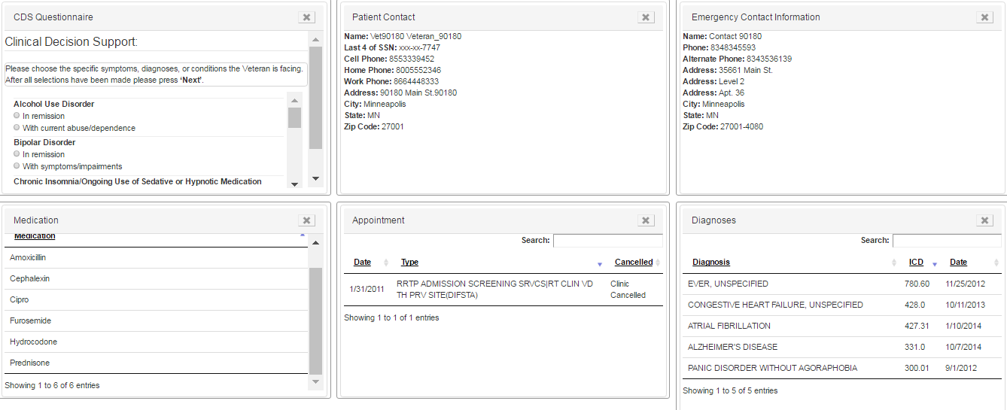
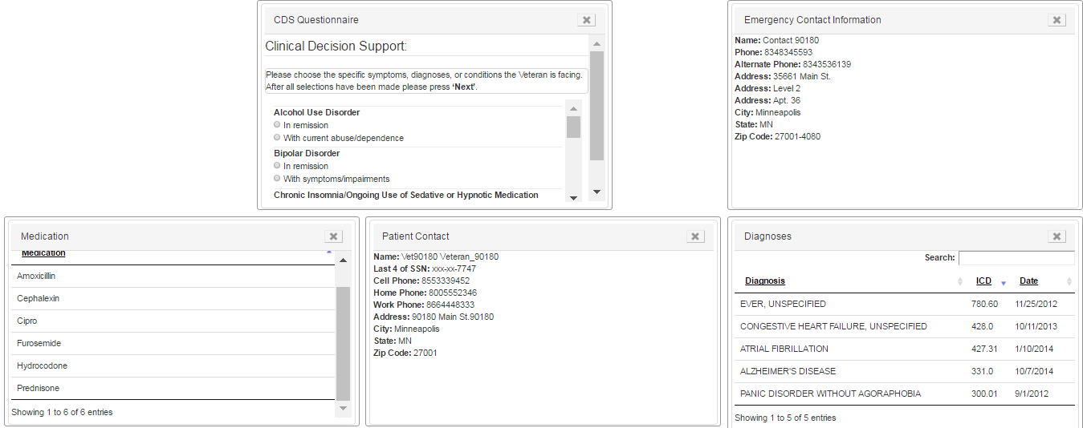
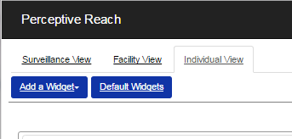
Customizing the Dashboard Moving a Widget
Customize the Dashboard– Slide 3/5
All widgets in the Perceptive Reach Dashboard can be moved to different locations. To move a widget, select the gray toolbar and drag the widget to the new location.
To reset the Dashboard widgets to their default sizes and locations, select the “Default Widgets” button that appears on the top left side of the Dashboard.
Return Home

Slide 14
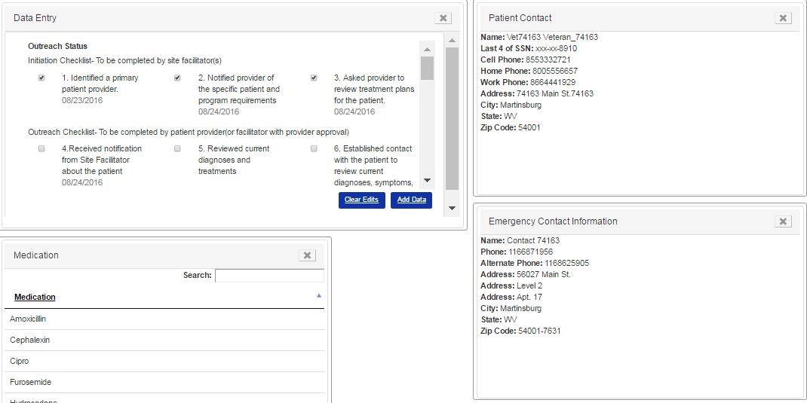
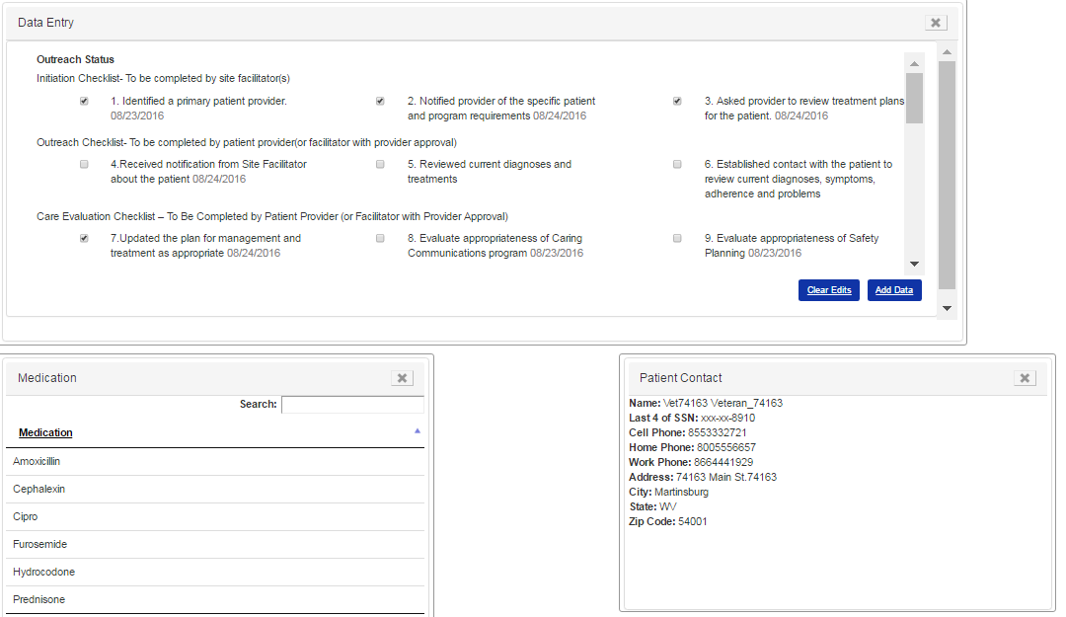
Customizing the Dashboard Resizing a Widget
Customize the Dashboard– Slide 4/5
All widgets in the Perceptive Reach Dashboard can be resized to different locations. To resize a widget, select any side of the widget and drag the widget to the desired size.
Return Home

Slide 15
Customizing the Dashboard Keyboard Navigations
Customize the Dashboard– Slide 5/5
IF you want to... | THEN select
Move forward from link to link or to controls | Tab
Move backward from link to link or to controls | Shift + Tab
Select rows for VISN or Facility Roster widgets | Spacebar
Traverse rows for VISN or Facility Roster widgets | Down and Up arrows
Exit table rows and return to widget navigation for VISN and Facility | Tab
Select rows for Patient Roster widgets | Enter
Traverse rows for Patient Roster widgets | Tab
Exit table rows and return to widget navigation for Patient Roster | Esc
Select/deselect boxes | Spacebar
Close a List Box | ALT + Up arrow
Open a List Box | ALT + Down arrow
Read the prior screen | CTRL + Page Up
Read the next screen | CTRL + Page Down
Go to the top of the page | CTRL + Home
Go to the bottom of the page | CTRL + End
Close the current window (in Internet Explorer) | CTRL + W
Refresh the screen | F5 or Ctrl + R
Go back a page | ALT + Left Arrow
Go forward a page | ALT + Right Arrow
Navigate to & select the text in the browser address combo box | ALT + D
Navigate to & access the browser home button | ALT + Home
Navigate to & access the browser favorites button | ALT + C
Navigate to & access the browser tools button | ALT + X
Resize the widgets in the dashboard, first Tab to the “X” in the upper right hand corner of the desired widget, then | Tab + Up Arrow OR Tab + Down Arrow
Move the widgets in the dashboard, first tab to the “X” in the upper right hand corner of the desired widget, then | Shift + A (Move Left) Shift + D (Move Right) Shift + W (Move Up) Shift + S (Multiple Times) (Move Down)
Scroll within the widgets in the dashboard, first tab to one of the items inside the desired widget, then | Page Up (Scroll Up) Page Down (Scroll Down)
Users have the option to navigate the Dashboard’s features using a mouse and / or keyboard. To navigate the application without a mouse, the following keys can be used to navigate exclusively through use of a standard keyboard. Keyboard navigation features apply to core features of the application such as the Perceptive Reach Dashboard. For details on keyboard navigation for related applications such as VLER Direct, BIRT, R, please see the user manual for those applications.
Return Home

Slide 16
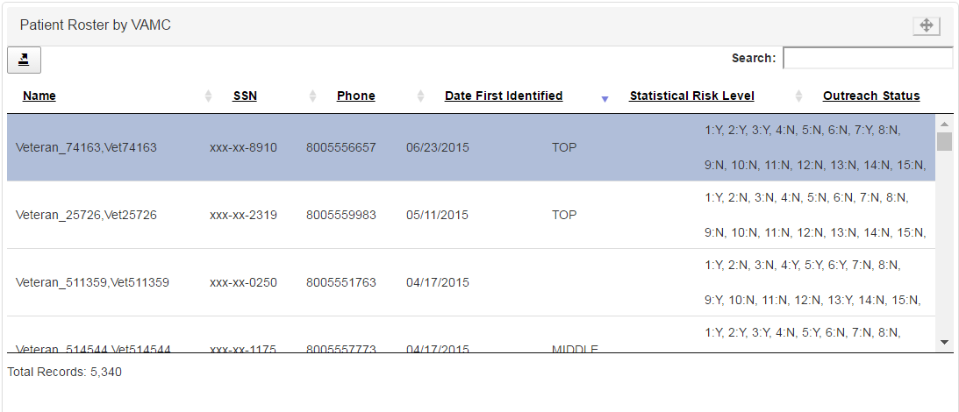
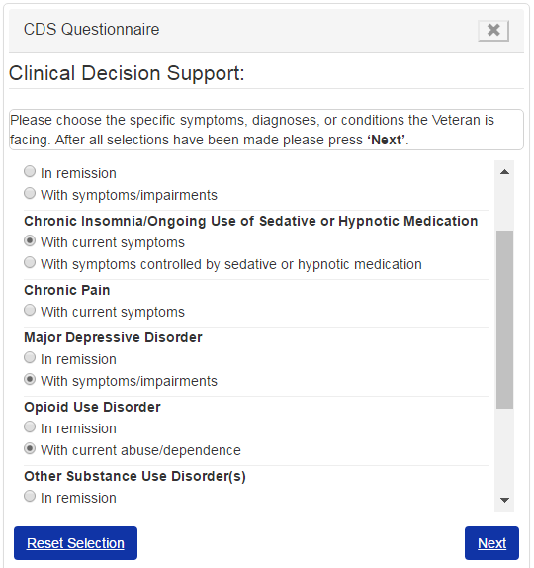
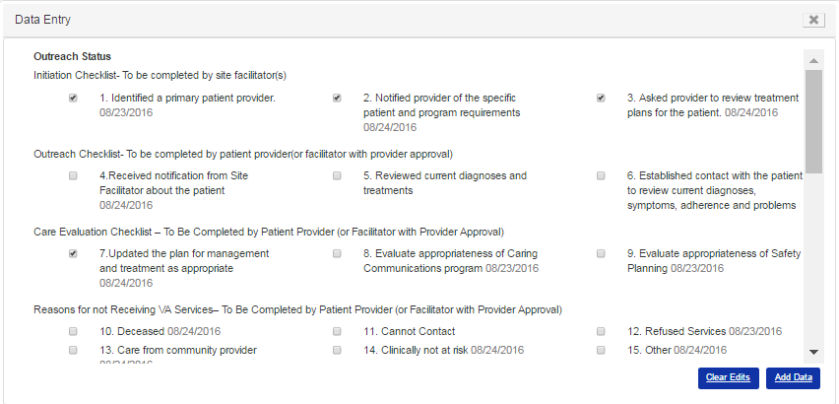
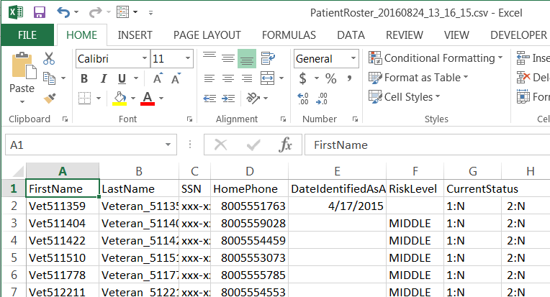
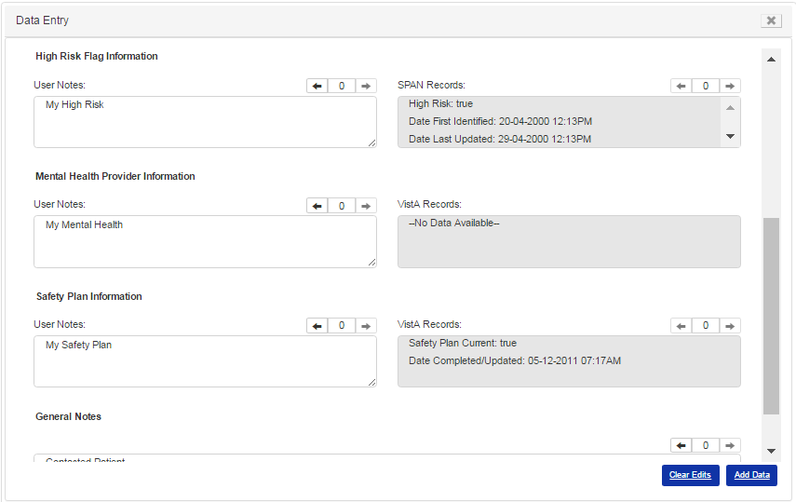
Individual View
Summary
Accessibility
The Individual view displays information at the patient-level. Clicking a Veteran in the Roster widget updates the Dashboard to show information related to the Veteran you selected. Users can see a Veteran’s phone number, last four digits of the Veteran’s Social Security Number, date first identified as at-risk, and the Veteran’s appointments, diagnoses, and medications.
Clinical Care Team Member (CCTM)
Clinical Care Supervisor (CCS)
National Supervisor
Special Features
Patient Roster Export
Clinical Decision Support (CDS) Widget
Data Entry Widget
Return Home

Slide 17
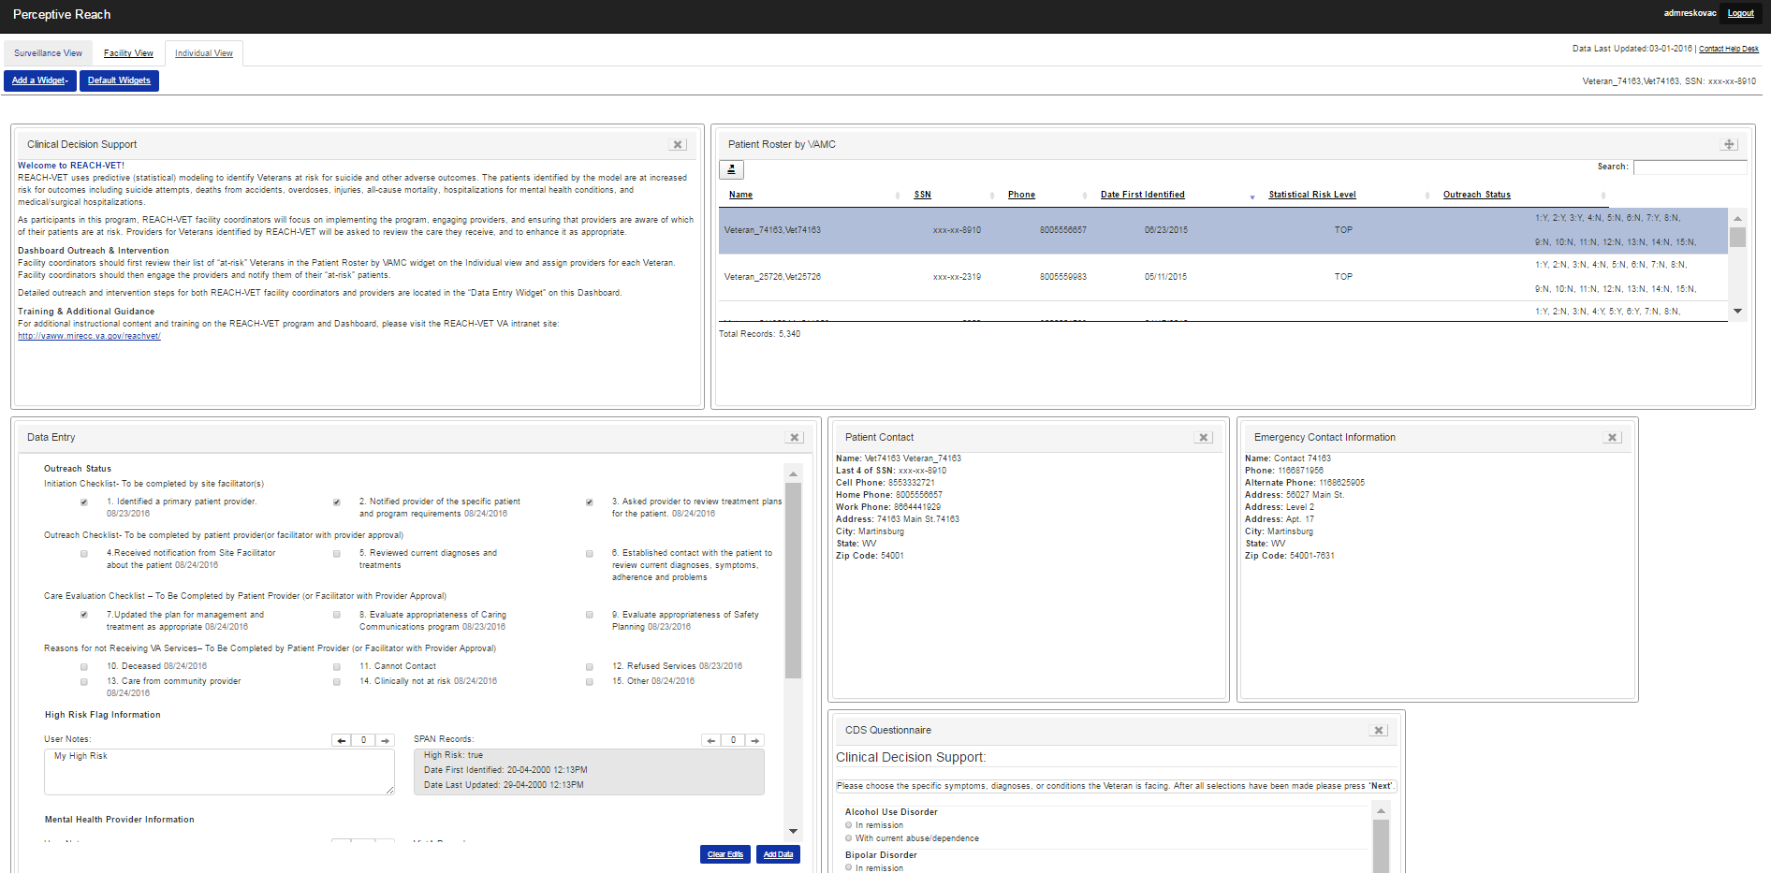
Individual View Locating Individual Patient Information
Return Home

Slide 18
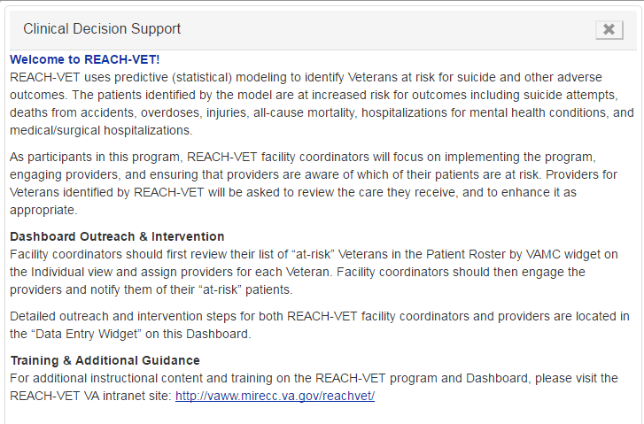
Intervention Guidance Widget Locating REACH-VET Program Information
Intervention Guidance
The Intervention Guidance widget displays general information regarding the REACH-VET program and Perceptive Reach application. This widget also explains:
Dashboard Outreach & Intervention Activities
Training & Additional Guidance
This widget provides REACH-VET coordinators with the initial steps they should take once they receive access to the Perceptive Reach Dashboard.
Return Home

Slide 19
Data Entry Widget Updating Outreach Status Checklist
Outreach Status – Slide 1/2
The Outreach Status Checklist is available at the top of the Data Entry widget. This checklist should be filled out frequently as the REACH-VET coordinator initiates care processes for Veterans. This checklist includes steps that both REACH-VET coordinators and care providers should follow when providing outreach and intervention services to at-risk patients.
When an item on the list is completed, a timestamp of when the item was checked off automatically appears within the widget. This timestamp allows other REACH-VET coordinators not directly involved in that patient’s care the ability to view the Veteran’s care history within the Perceptive Reach Dashboard.
Return Home

Slide 20
Outreach Status Display Viewing Outreach Status in the Patient Roster by VAMC widget
Outreach Status – Slide 2/2
The Outreach Status column in the Patient Roster by VAMC widget displays values for the checklist items listed in the Outreach Status Checklist within the Data Entry widget. This column provides users with a quick view of which entries in the Outreach Status Checklist are complete and incomplete. A “Y” value indicates that the checklist item is complete and an “N” value indicates that the item has not yet been checked off.
Return Home

Slide 21
Data Entry Widget Saving Notes in the dashboard
The Data Entry widget is available on the Individual view and allows users to save notes directly in the Dashboard. Users also have the ability to view historical entries saved in the Data Entry widget via the left and right arrows that appear at the top of each field. The following free-text fields are available on the left side widget:
High Risk Flag
Mental Health Provider
Safety Plan Information
General Notes
Users can update these fields when they want to save patient-related information in the Perceptive Reach Dashboard.
The following system of record fields are available on the right side of the widget:
High Risk Flag – SPAN Records
Mental Health Provider – VistA Records
Safety Plan – VistA Records
These read-only fields will be updated in the Dashboard automatically as new system of record information is available.
Return Home

Slide 22
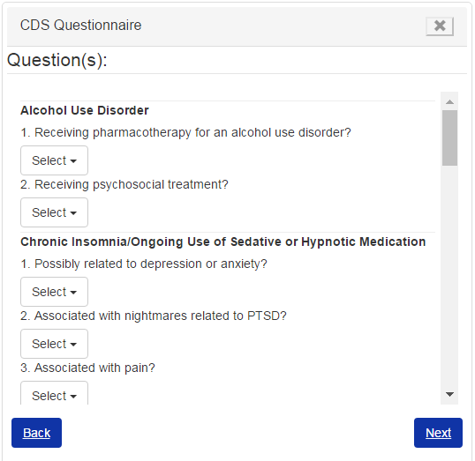
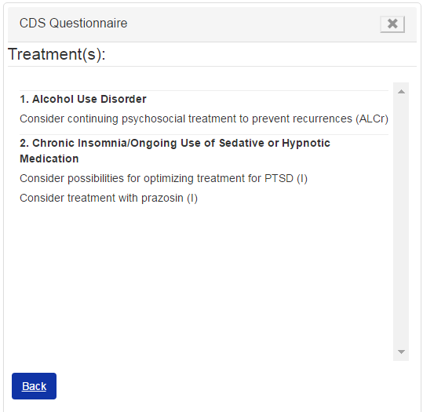
Clinical Decision Support (CDS) Questionnaire Widget Finding Recommended Treatments
1
2
3
The ‘CDS Questionnaire’ widget is a tool on the Individual view that allows users to find recommended treatments based off of the conditions a Veteran is facing. On the first page, users select the conditions that are currently affecting the Veteran. The second page prompts the user to answer questions about these conditions. The final page displays recommended treatments based on the user’s selections and answers in the first two web forms.
Return Home

Slide 23
Patient Roster by VAMC Widget Export Function Export Excel Document
Users have the ability to export information from the Patient Roster by VAMC widget on the Individual view to an Excel spreadsheet that they can edit and locally save on their computer. To export the Excel spreadsheet, locate the export button which appears in the top left corner of the Patient Roster by VAMC widget. After selecting this button, the browser will prompt the user to (1) Open, (2) Save, or (3) Cancel the export of the Excel Spreadsheet. If the “Open” option is selected, the exported Excel spreadsheet will appear.
Return Home

Slide 24
Facility View
Summary
Accessibility
The Facility view displays information at the facility-level. Users with CCTM access will only be able to see data from their “home” facility by default. CCS and Supervisor users can select a facility in the Roster widget to update the Dashboard with information related to the selected facility. The other Facility view Dashboard widgets show information related to Veteran Outreach Status, Gender, Military Service Branch, and Age Group aggregated at the facility level.
Clinical Care Team Member (CCTM)
Clinical Care Supervisor (CCS)
National Supervisor
Return Home

Slide 25
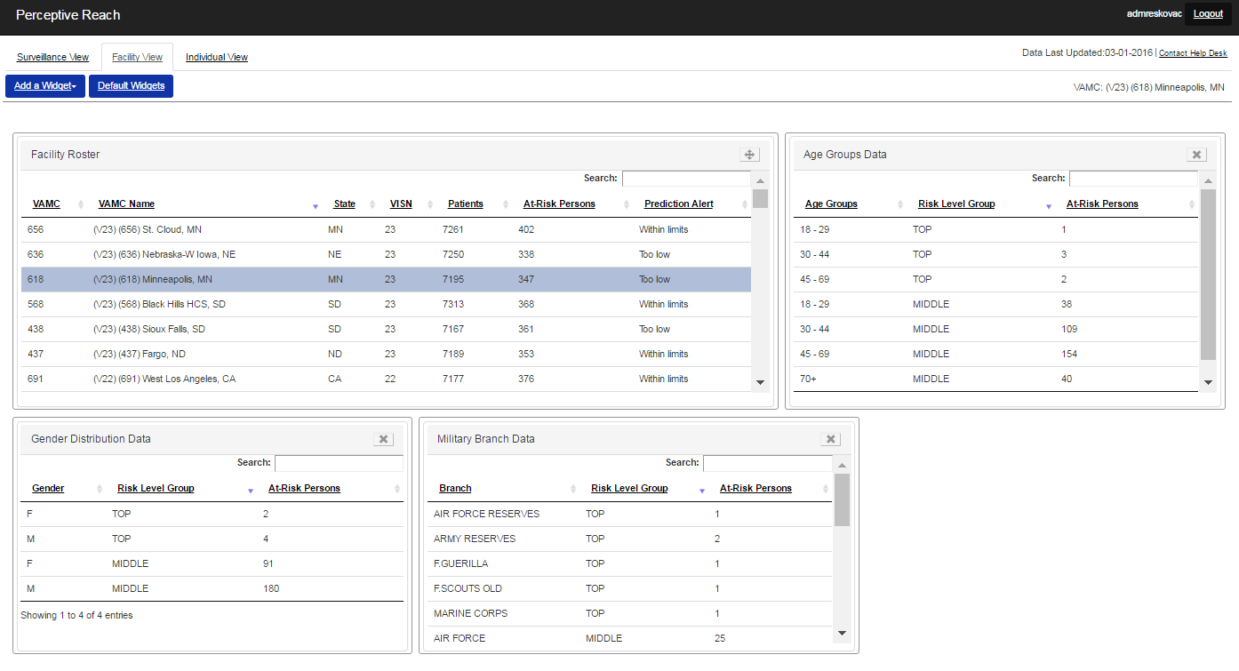
Facility View Locating Facility Information
Return Home

Slide 26
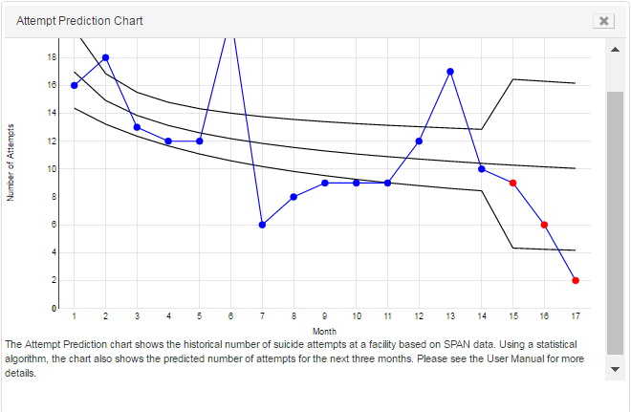
Surveillance View
Summary
Accessibility
The Surveillance view displays information at the National, VISN, and Facility levels. Only Supervisor users with national access will be able to see this Dashboard view. Users can select a VISN and facility in the Roster widgets to update the other Dashboard widgets with information related to the selected VISN or facility.
National Supervisor
Special Features
Attempt Prediction Chart
Return Home

Slide 27
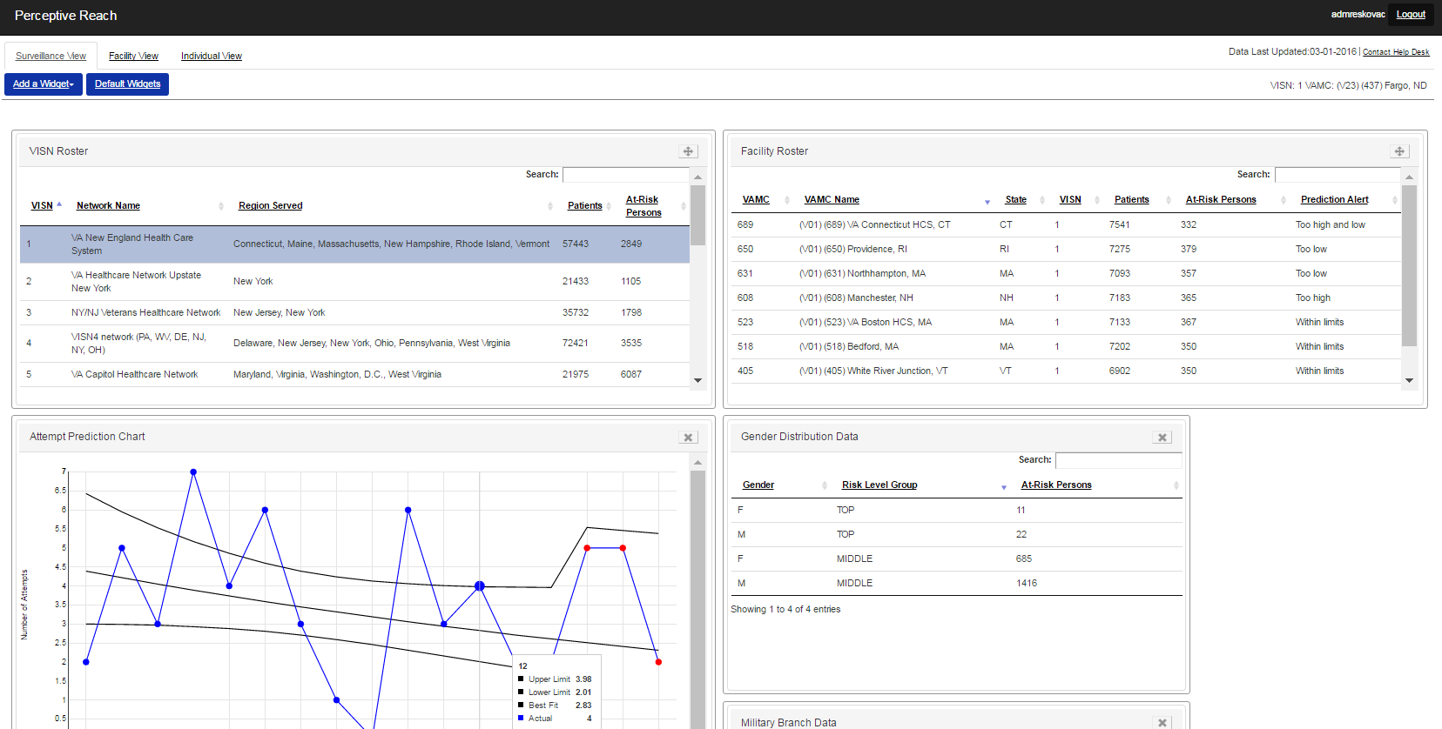
Surveillance View Locating National Facility & VISN Information
Return Home

Slide 28
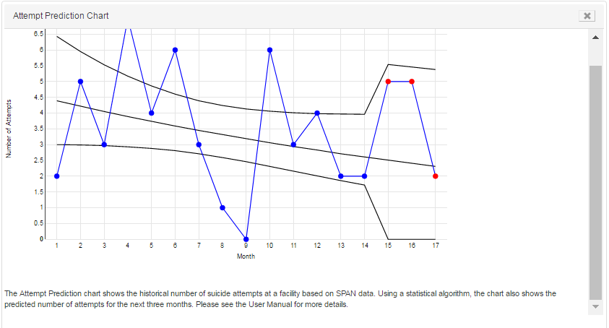
Attempt Prediction Chart
The ‘Attempt Prediction Chart’ widget displays monthly patient attempt data for a selected facility in line graph format. It provides users with longitudinal trends of monthly reportable incidents for the previous 17 months. The user has the ability to hover their mouse over the dots on the line graph to view actual data along with upper limit, lower limit, and the line of best fit metrics.
Return Home

